Slide 1
Farmer Support and Advisory Portal
Asavari Tayal
Notes:
Hello. My name is Asavari. I am a PM Intern with the Ignite Apps Team for Power Apps.

Slide 2
Agenda
Dashboard and Portal Design
Value chain catalogue
Concept of ‘Reports’
Online Marketplace
Communicating with the end user
Notes:
Today I’ll sharing a snippet of my internship this Summer and talking more about how my contribution inspires a better end to end experience for Power Apps.

Slide 3
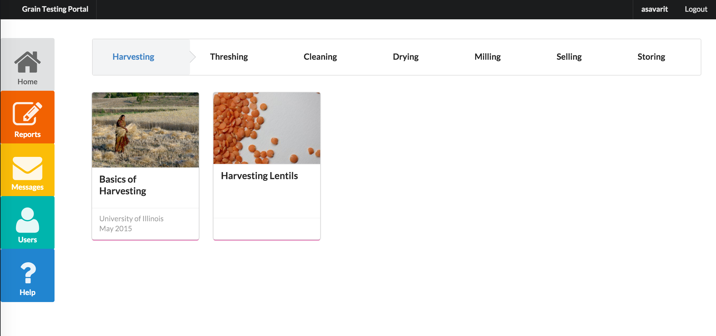
Portal Design – Dashboard View
Notes:
Today I’ll sharing a snippet of my internship this Summer and talking more about how my contribution inspires a better end to end experience for Power Apps.

Slide 4






Portal Design – Dashboard View
The landing page
Personal and contact
information of the Farmer
Viewing and
publishing reports
Education about the portal
Communication with the
University, information log
from the sensors and messages
from the buyer
Portal Settings / Alerts
Notes:
Today I’ll sharing a snippet of my internship this Summer and talking more about how my contribution inspires a better end to end experience for Power Apps.

Slide 5
Value Chain Catalogue
Notes:
Today I’ll sharing a snippet of my internship this Summer and talking more about how my contribution inspires a better end to end experience for Power Apps.

Slide 6
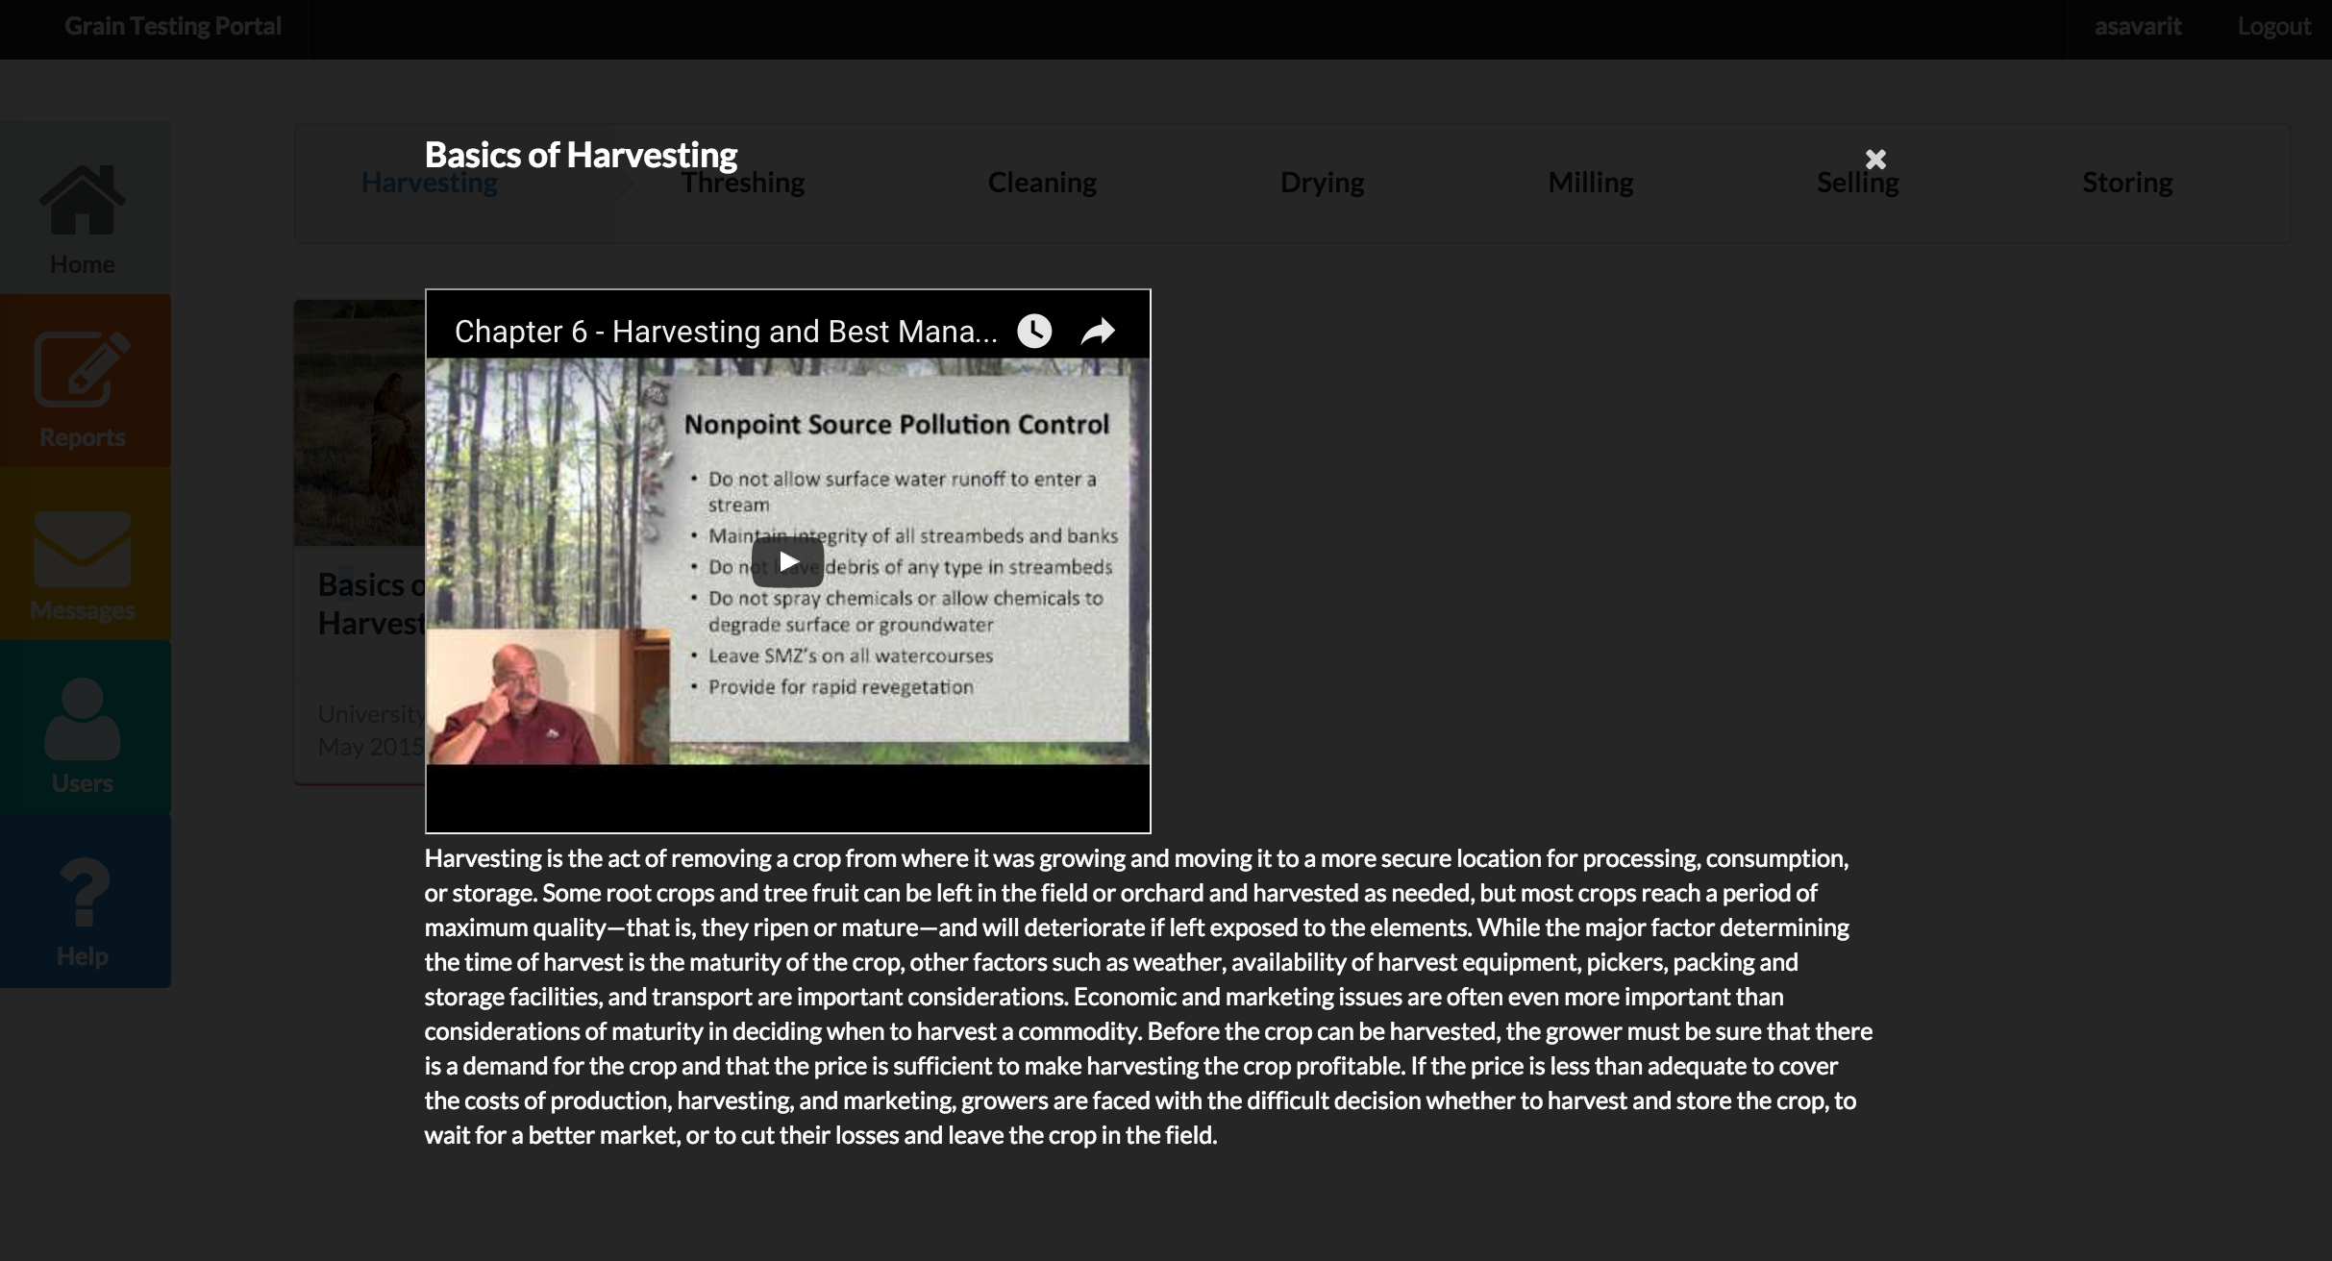
Notes:
Today I’ll sharing a snippet of my internship this Summer and talking more about how my contribution inspires a better end to end experience for Power Apps.

Slide 7
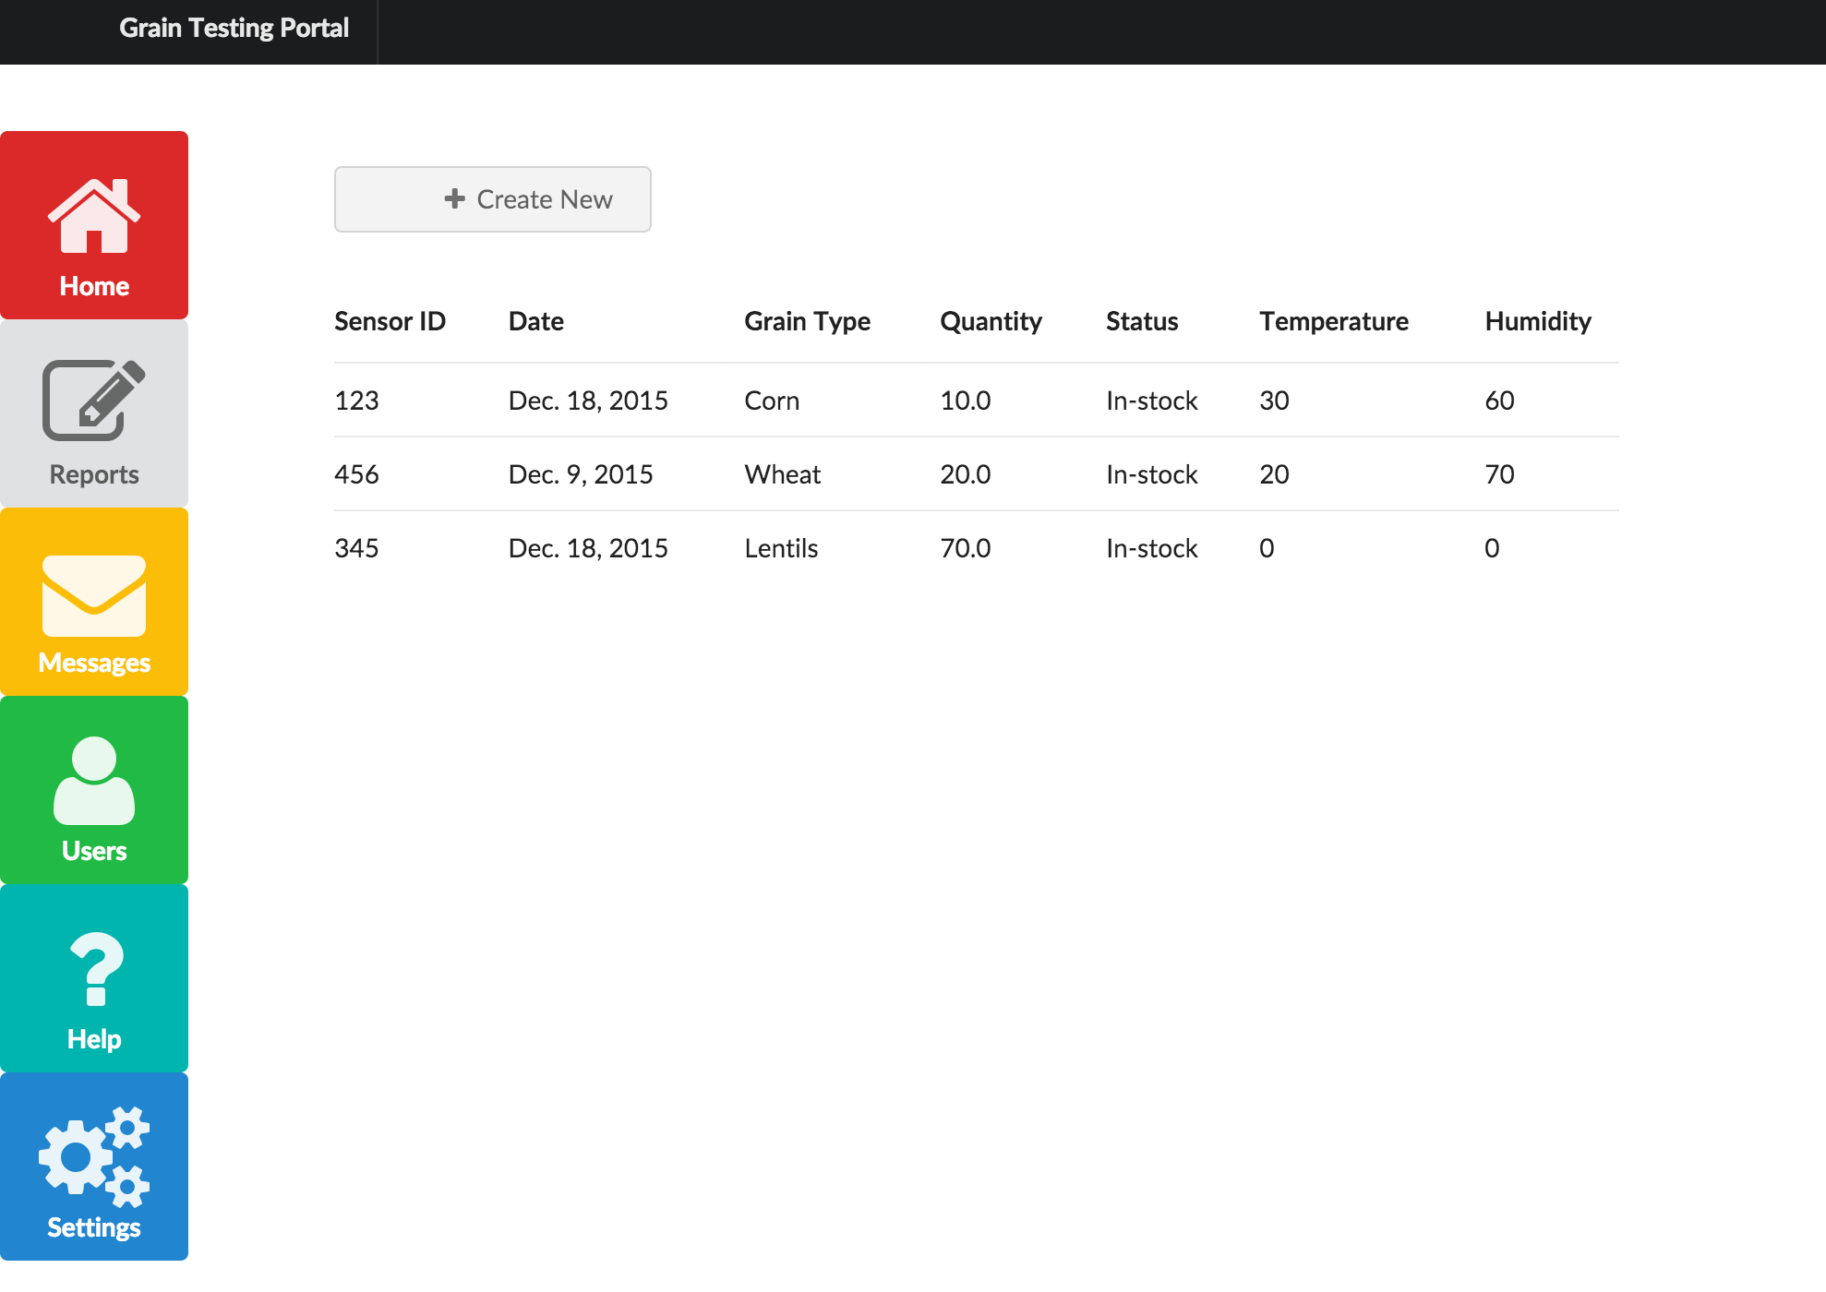
Reports View
Notes:
Today I’ll sharing a snippet of my internship this Summer and talking more about how my contribution inspires a better end to end experience for Power Apps.

Slide 8
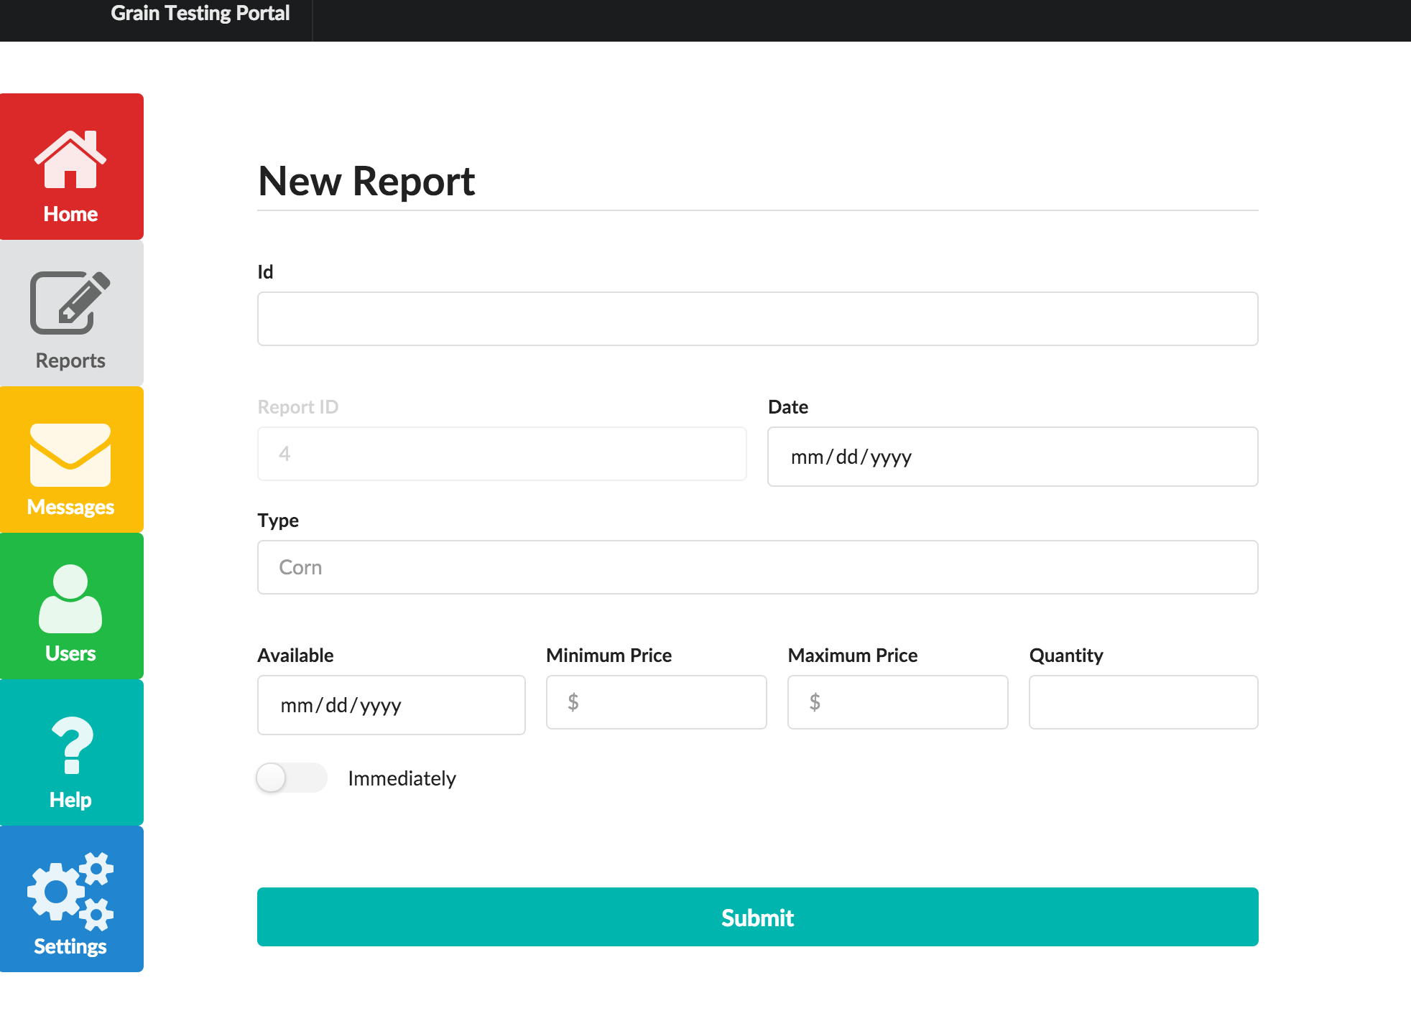
Creating a Report
Notes:
Today I’ll sharing a snippet of my internship this Summer and talking more about how my contribution inspires a better end to end experience for Power Apps.

Slide 9
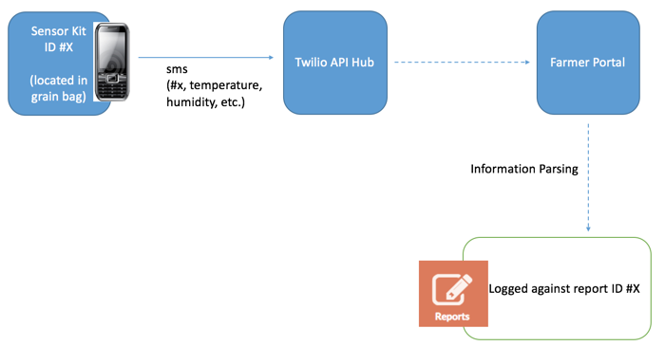
Information from Sensors
Notes:
Today I’ll sharing a snippet of my internship this Summer and talking more about how my contribution inspires a better end to end experience for Power Apps.

Slide 10
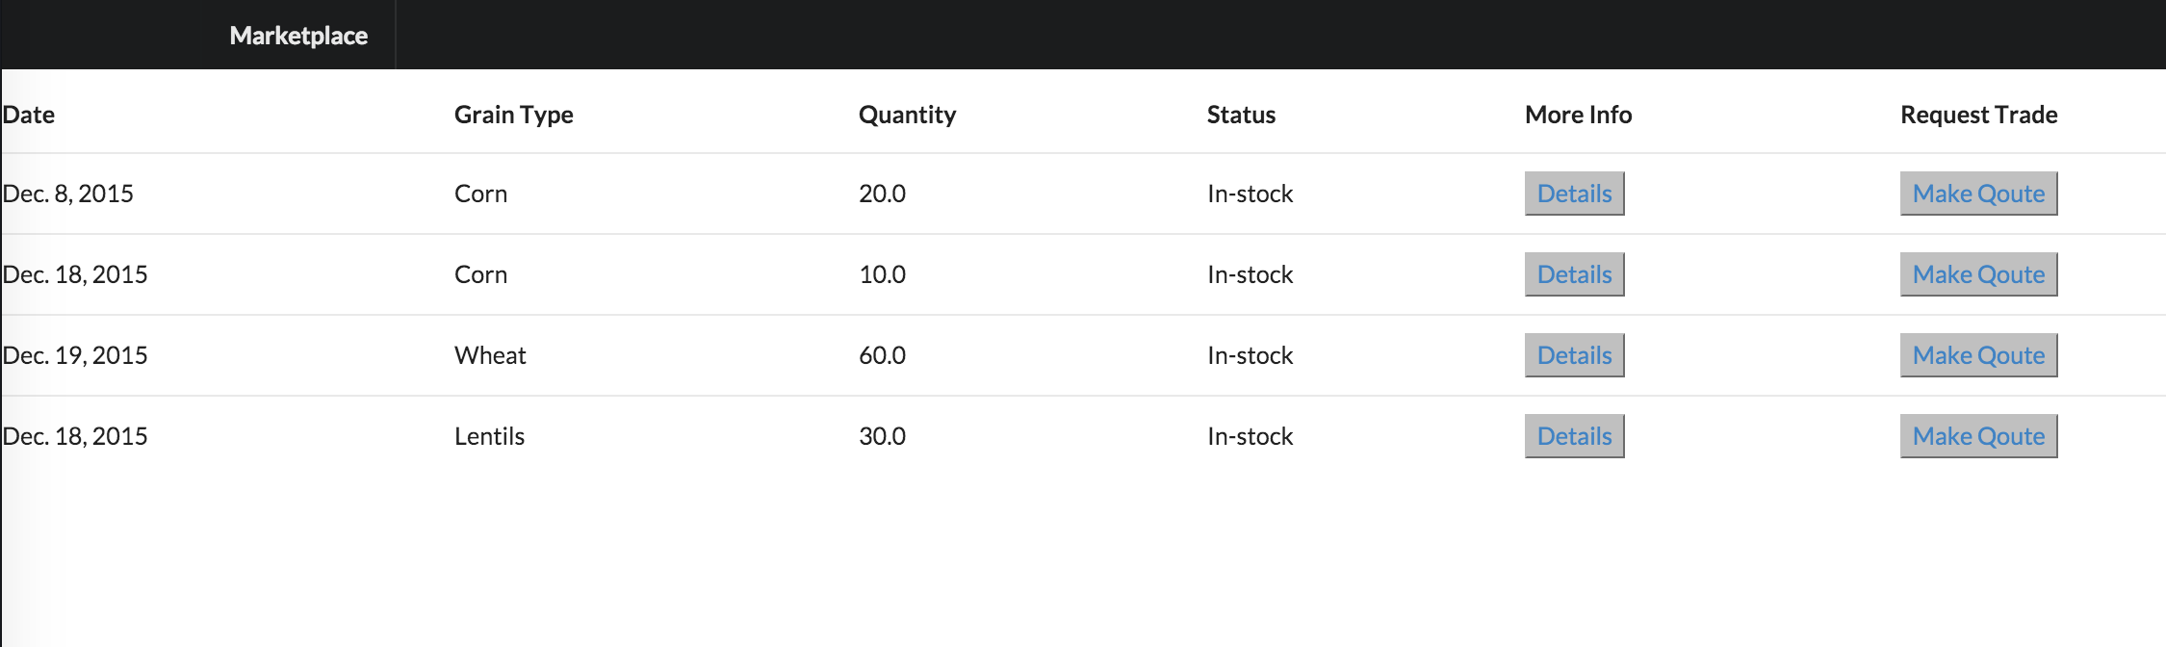
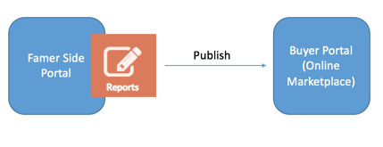
Online Marketplace
Notes:
Today I’ll sharing a snippet of my internship this Summer and talking more about how my contribution inspires a better end to end experience for Power Apps.

Slide 11
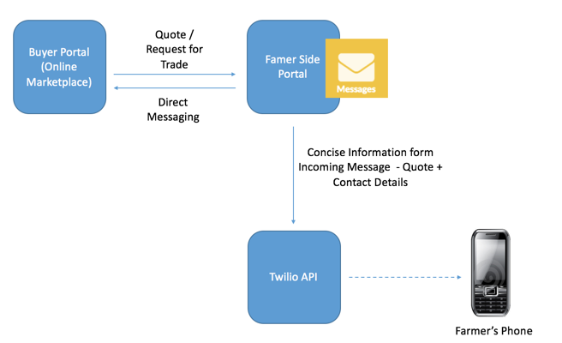
Requesting Trade
Online Marketplace
Notes:
Today I’ll sharing a snippet of my internship this Summer and talking more about how my contribution inspires a better end to end experience for Power Apps.

Slide 12
Portal Demo
Notes:
- From amongst a pool, I will be demoing three different templates today that I modelled and drove in collaboration with engineering and design team

